Slide 1
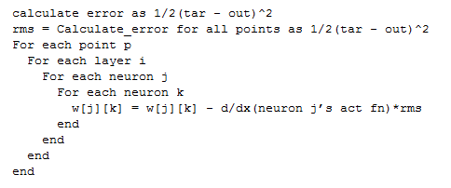

Slide 2
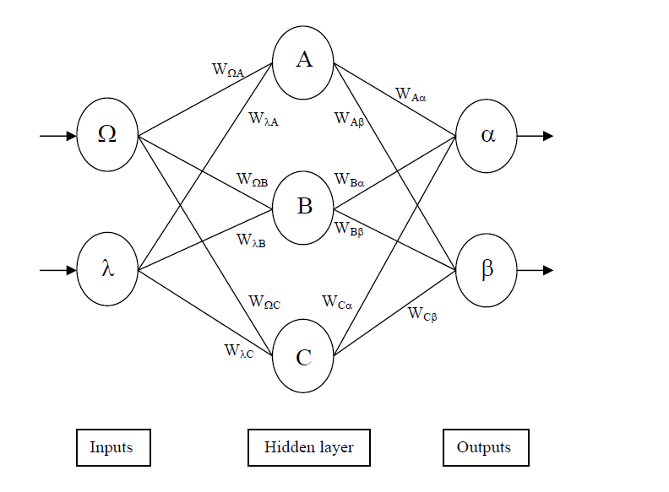

Slide 3
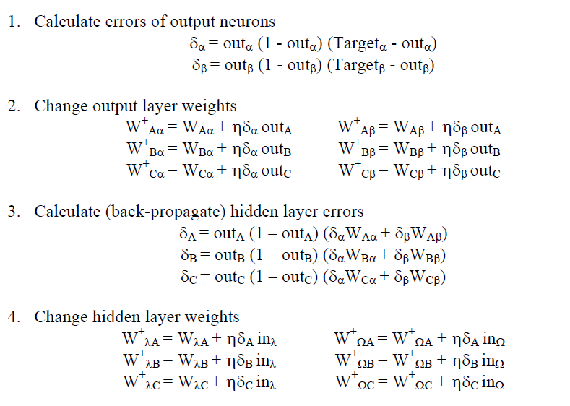
C-0.0397lc_delt-0.0397_out
Up_weights
C-0.0397lc_delt-0.0397

Slide 4
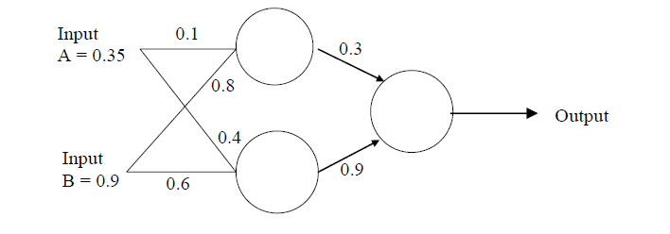
0
0
1
1
0 | 1 | 2
1
1
0.1 | 0.8
0.4 | 0.6
0.3 | 0.9

Slide 5
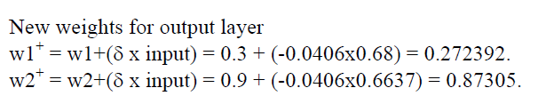
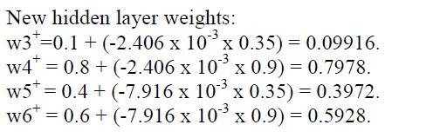
0 |  | 1 |  |  | 2
0.35 |  | 0.1 | 0.8 |  | 0.3 | 0.9
0.9 |  | 0.4 | 0.6
0 |  | 1 |  |  | 2
1 |  | 0.09916 | 0.7978 |  | 0.27236 | 0.872998
1 |  | 0.3972 | 0.5928

Slide 6
E = ½(Err^2)
E = ½(t_p – o_p)^2
Ch-0.0397nge in Error with respect to
Ch-0.0397nge in weight
j
W_jk
k
k
k
k
k
k

Slide 7
0
0
1
1
0 | 1 | 2
1
1
0.1 | 0.8
0.4 | 0.6
0.3 | 0.9

Slide 8
Ffwd with Bi-0.0397s
1
1
1
bi-0.0397s
bi-0.0397s
Ffwd output should be
(0.3*0.8526)+(0.9*0.8429)+1
subs(sig, 2.0144) = 0.8823

Slide 9
Back Propagation with Bias
Delta 0 = (0.5 - 0.8823)*(1-0.8823)*(0.8823)= -0.0397
Weight updates
0.3 + (-0.0397*.8526) = 0.2662
0.9 + (-0.0397*.8429) = 0.8665
Bias update: 1 + -0.0397 = 0.9603
Delta 0: .2662*-0.0397*.8526*(1-.8526)= -0.0013
Delta 1: .8665*-0.0397*. 8429 *(1-. 8429 )= -0.0046
Weight updates
0.1 + (-0.0013*.35) = 0.0995
0.8+ (-0.0013*.9) = 0.7988
0.4+ (-0.0046*.35) = 0.3984
0.6+ (-0.0046*.9) = 0.5959
Bias updates: 1 + -0.0013 = 0.9987
Bias updates: 1 + -0.0046 = .9954

